Slide 1
PREDICTING WHETHER A PATIENT HAS DIABETES THROUGH DIAGNOSTIC MEASUREMENT
ITMD 527 – Data Analytics
UNDER THE GUIDANCE OF
PROF. Yong Zheng

Slide 2
TEAM NUMBER - 50 PROJECT MEMBERS
Nikita Kothari A20373125
Shwetha Gopalarathinam A20372679
Sreekumar Selvam A20372235
Srilekha Napa Ugandhar A20370759

Slide 3
TYPES OF DATA
NUMERIC
Pregnancies
Glucose
Blood Pressure
Skin Thickness
Insulin
BMI
Diabetes Pedigree Function
Age
CATEGORICAL
Outcome

Slide 4
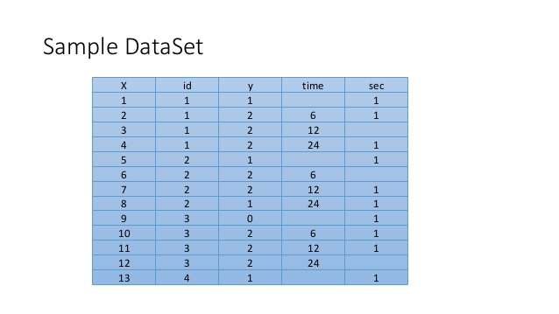
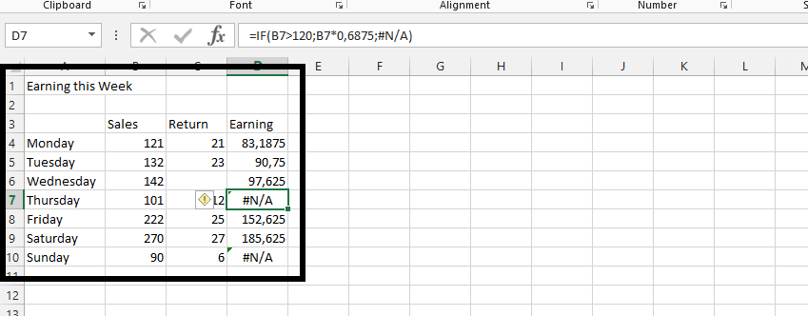
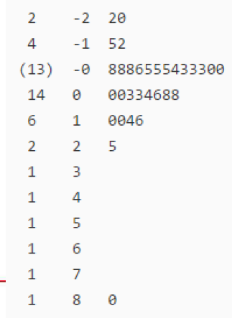
DATA CLEANING
MISSING VALUES EMPTY/ZERO VALUES OUTLIERS

Slide 5
MODEL EVALUATION
Helps to find the best model that represents our data and how well the chosen model will work in the future.
Forward Model
Backward Model
Stepwise Regression

Slide 6
INTRODUCTION AND DESCRIPTION
Why use Logistic Regression?
Interpreting coefficients
Estimation by maximum likelihood
Hypothesis testing
Evaluating performance of the model

Slide 7
LOGISTIC REGRESSION
Form of regression that allows prediction of discrete variables by a mix of continuous and discrete predictors.
Addresses the same questions that discriminant function analysis and multiple regression do but with no distributional assumptions on predictors.
Measures relation between categorical dependent variable and one or more independent variable.
Estimates probabilities using logistic function.

Slide 8
WHY USE LOGISTIC REGRESSION?
There are many important research topics for which dependent variable is “limited.”
For example: voting, mortality and participation data is not continuous or distributed normally.
Binary logistic regression is a type of regression analysis where dependent variable is a dummy variable: 0(did not vote) or 1(did vote)

Slide 9
CONFUSION MATRIX
With the Predicted Value of 247 observations
We Found that,
True Positives values :141
False Negative values :50
False Positive Values :16
True Negative values :40
N = 247 | Predicted: NO 0 | Predicted : YES 1
Actual :NO 0 | 141 | 50
Actual : YES 1 | 16 | 40

Slide 10
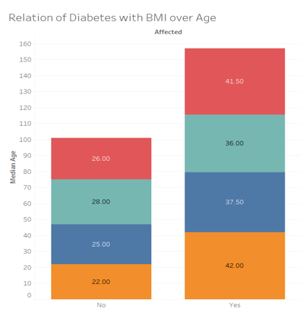

RELATION OF DIABETES WITH BMI OVER AGE
This graph depicts the relationship of the BMI values with Median of Age Values

Slide 11
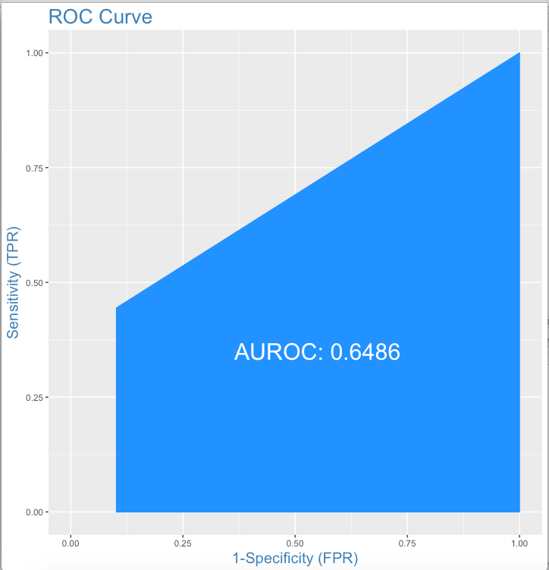
ROC CURVE
Traces the percentage of the True Positives accurately from the given logit model.

Slide 12
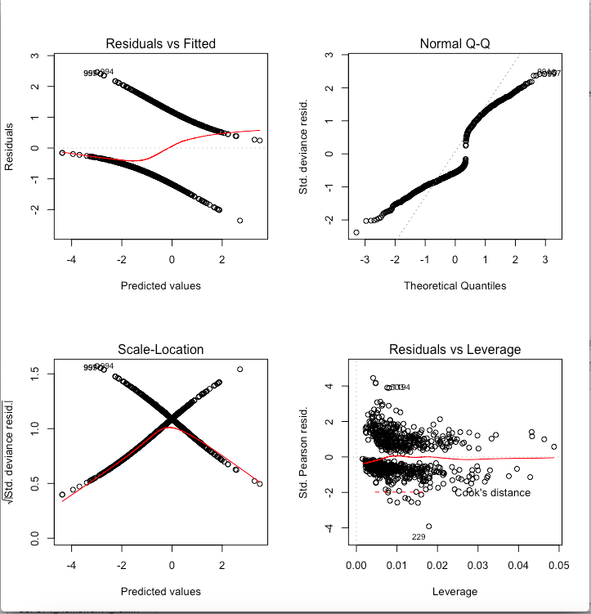
RESIDUAL ANALYSIS

Slide 13
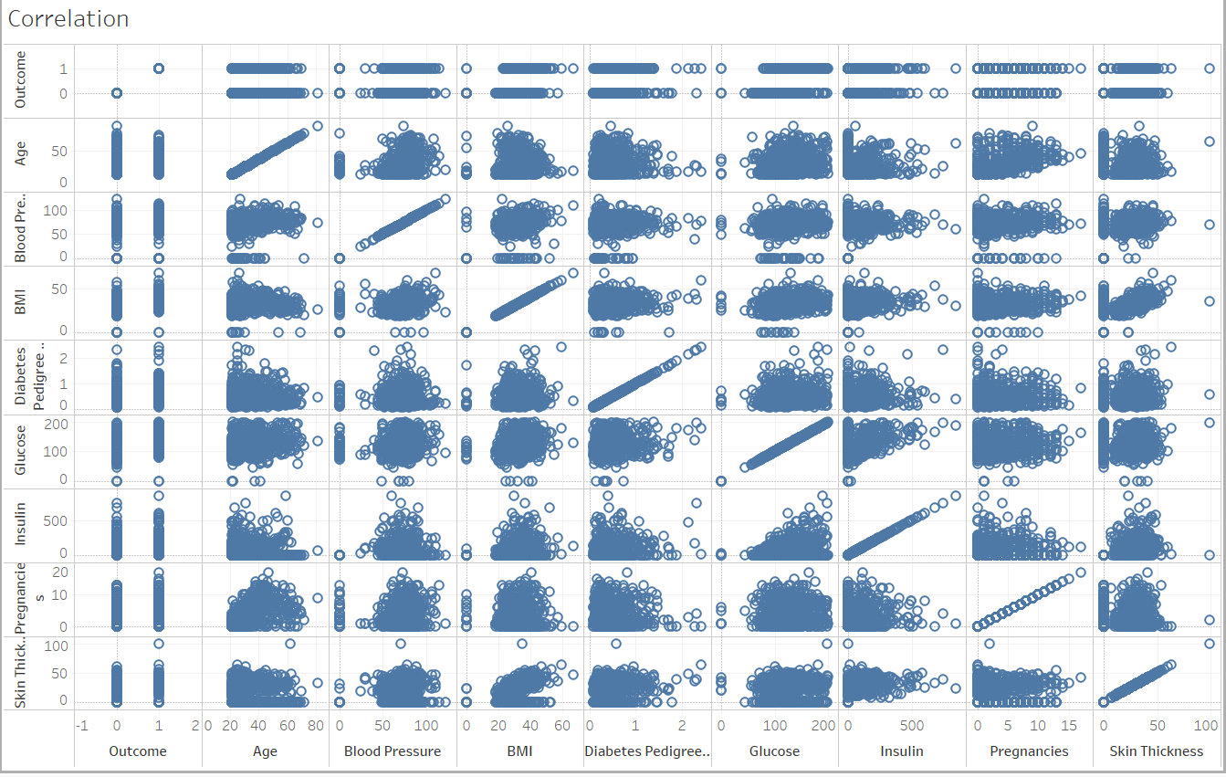
CORRELATION PLOT
This correlation Matrix depicts the linear relationship between the independent variables.

Slide 14
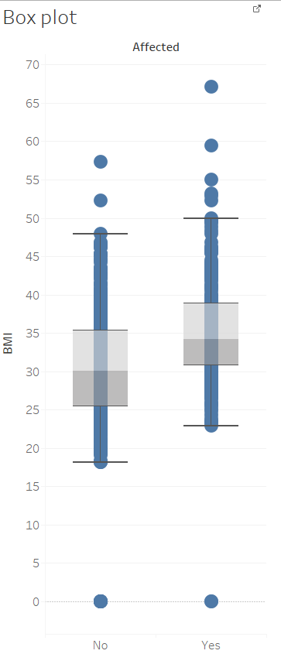
BOX PLOT
This graph depicts the relationship between the outcome and BMI range values

Slide 15
CONCLUSION
By prediction , accuracy rate of diabetes was found to be 73.279 .
Based on Analysis ,the influential diabetic factors are concluded to be glucose, BMI ,Pregnancies, Blood Pressure and Diabetes Pedigree Function.
Based on our fitted model, Age is not a parameter to determine the risk of diabetes.
The best fitted model was concluded to be stepwise regression model .

Slide 16


